Slide 1

Design and Development of Virtual Campus System Using PHP & MYSQL
Submitted By
Supervised By
Yasna Afrin
ID : 312CSE0004
Batch : 19th
Department : CSE
Program : B.Sc. in CSE
The Millennium University
Dr. Md. Zahedul Hassan
Head of the Department
CSE & ICT Department
The Millennium University

Slide 2
Introduction
Virtual campus refers to the online offerings of our university where university work is completed either partially or wholly online, often with the assistance of the teacher, professor, or teaching assistant.
Many established and mainstream universities now offer many courses (or entire degree programs) either partially or wholly online. Many features have been developed in our system like user sign in, sign up or registration, sharing important posts, changing user information, user profile information, friend request options, home page, virtual-campus drag and drop box etc.

Slide 3
Benefits of Virtual Campus
Promotes greater communication between classmates
Time and space flexibility
Cost-effective for learners
Allows students to take control of their own learning
Makes it easy for students to ask for help
Gives students the opportunity to practice whenever they like.

Slide 4
Development Methodology of Virtual Campus
The waterfall model is a sequential (non-iterative) design process, used in software development processes, in which progress is seen as flowing steadily downwards (like a waterfall) through the phases of conception, initiation, analysis, design, construction, testing, production/implementation and maintenance
Waterfall Model of the project
2
Sorting Requirements
Data Collection
Data Analysis
Architecture Development
System Design
Implementation
System Development
1
Data Collection
Sorting Requirements
5
6
Design
Implementation
3
7
Analysis Data
System Development
4
Architecture Development
Fig 1.0: Waterfall Model

Slide 5
Architecture of Virtual Campus
Virtual-campus
Login
Profile
Home
Settings
Signup/Login
Profile Information
User Profile Id
Profile Picture Upload
Picture Upload
Post Status
Chat System
Edit Personal Information
Messaging
Friend List
Chat System
Bio Data
Friend Request
Make Important Post
Change Password
Search Option
Status Date Mentioned
Add Social Connections
Post Status
Options and Tools
Upload
Photo Gallery
Search Options
Comments
Download
Friend Request Options
Delete
Messaging
Timeline Option
Timeline Option
Add
Like System
Like System
Remove Post Status
Virtual Box
Fig 2.0: Project Architecture

Slide 6

Use Case Diagram
Registered User
Unregistered User
Registration
Login
Profile update
Post status
View Profile
Upload photo
Make important post
Biography update
Search friends
comments
Change profile picture
Send friend request
Poke
See friend request
Accept request
chat
Logout
Fig 3.0: Use case diagram

Slide 7
Database Design
 | chat
PK | id
 | user_from
 | user_to
 | chat
 | sent
 | posts
PK | post_id
 | body
 | date_added
 | username
 | password
 | user_posated_to
 | status_pic
 | importance
 | users
 | fname
 | lname
 | user_from
 | email
 | password
 | gender
 | sign_up_date
 | activated
 | profile_picture
 | friend_array
 | message
PK | id
 | user_from
 | user_to
 | Message_body
 | sent
 | comments
 | c_id
FK | post_id
 | user_comments
 | comments_user
 | friend_request
PK | id
 | user_from
 | user_to
 | accept
 | like
PK | id
FK | post_id
 | like
 | unlike
PK | id
FK | post_id
 | unlike
Fig 4.0: Database Design

Slide 8
Entity Relationship Diagram
Entity
Relationship
Attributes
chat
comments
friend_request
users
id
c_id
id
id
chat_from
user_from
fname
post_id
lname
chat_to
user_comments
username
message
user_to
email
comments_user
password
sent
gender
posts
sign_up_date
id
activated
like
body
profile_picture
id
post_id
date_added
friend_array
like
added_by
batch
user_posted_to
identity
unlike
status_pic
department
id
importance
program
post_id
Fig 5.0: Entity Relationship
bio_data
unlike

Slide 9
Development Tools
Sublime Text 3
Bootstrap
XAMMP
HTML
CSS
JavaScript
Jquery
PHP
MySQL
Pixie (Color Picker)

Slide 10
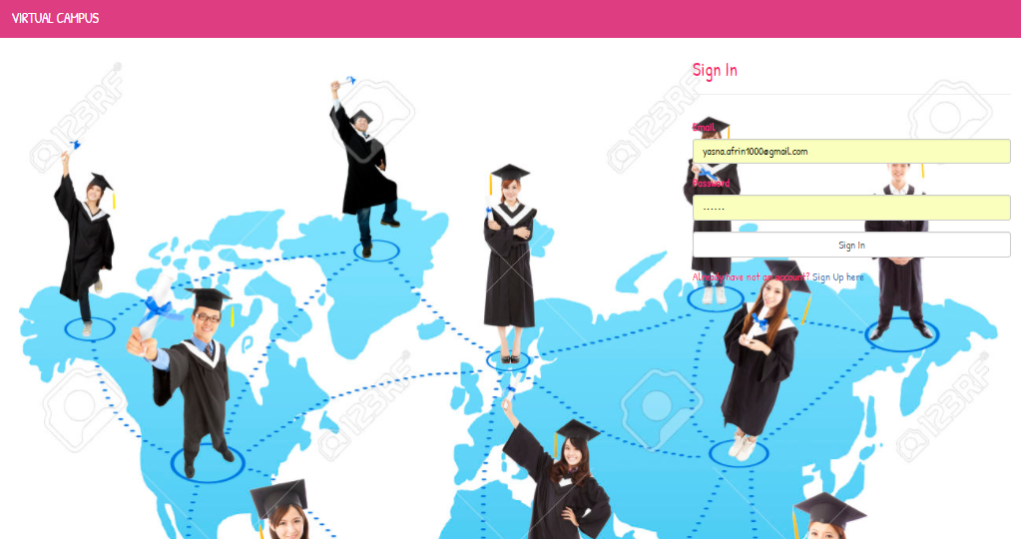
User Sign in

Slide 11
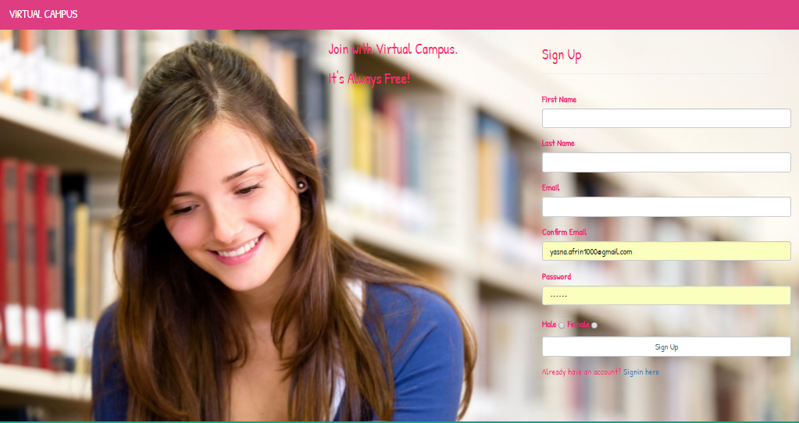
User Sign up or registration

Slide 12
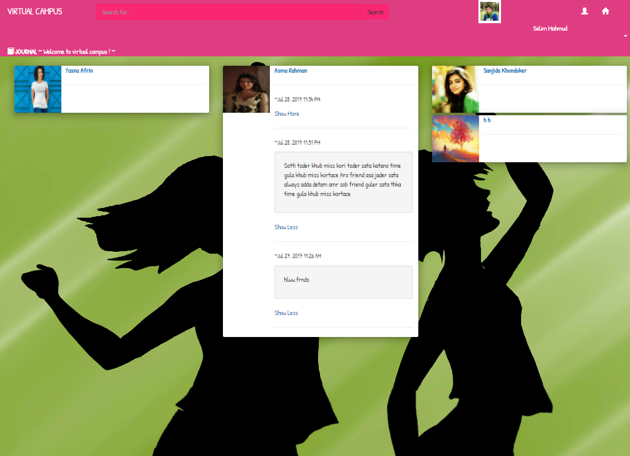
Sharing Important posts

Slide 13
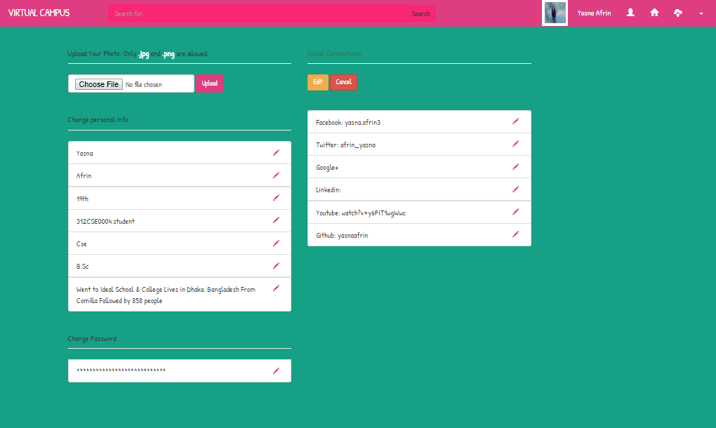
Changing User Information

Slide 14
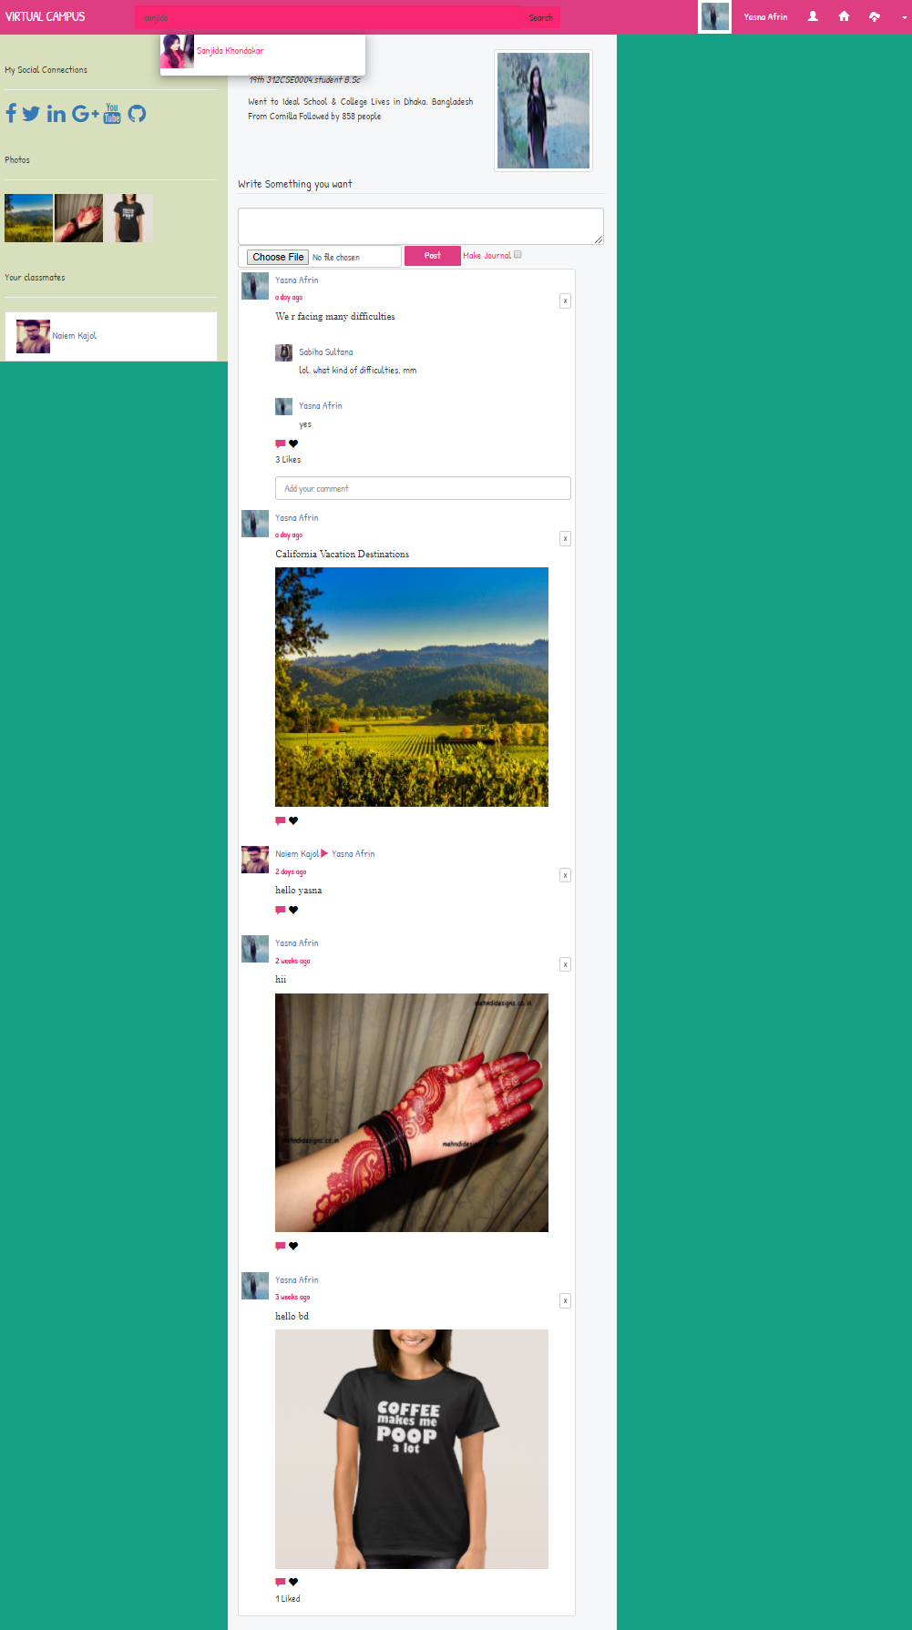
User Profile Information

Slide 15
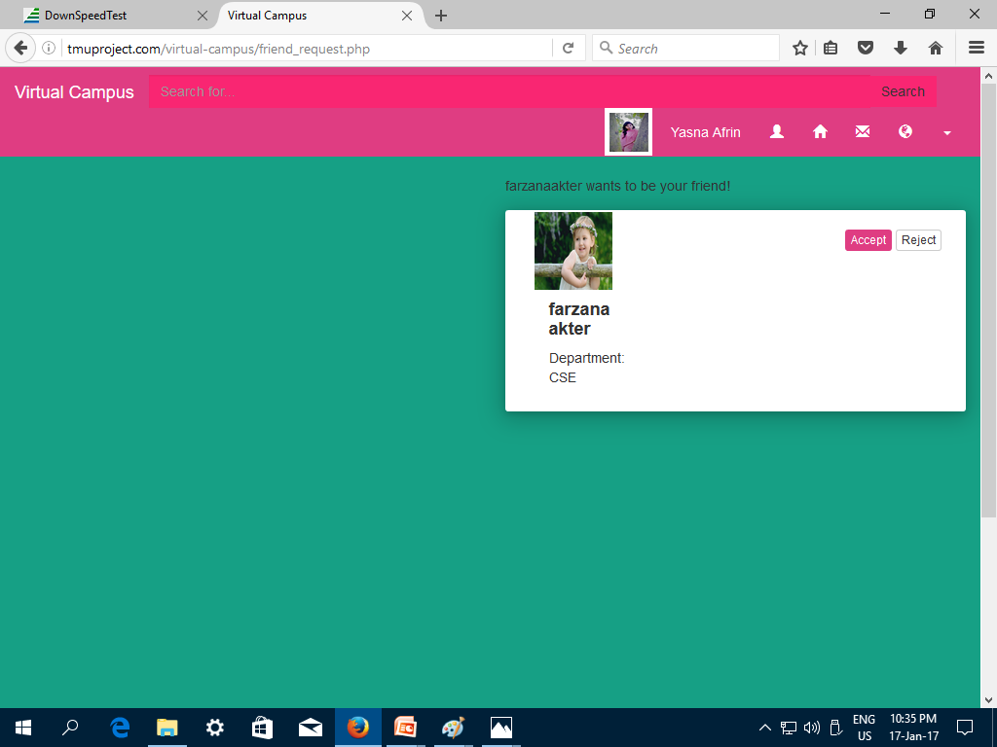
Friend Request Options

Slide 16
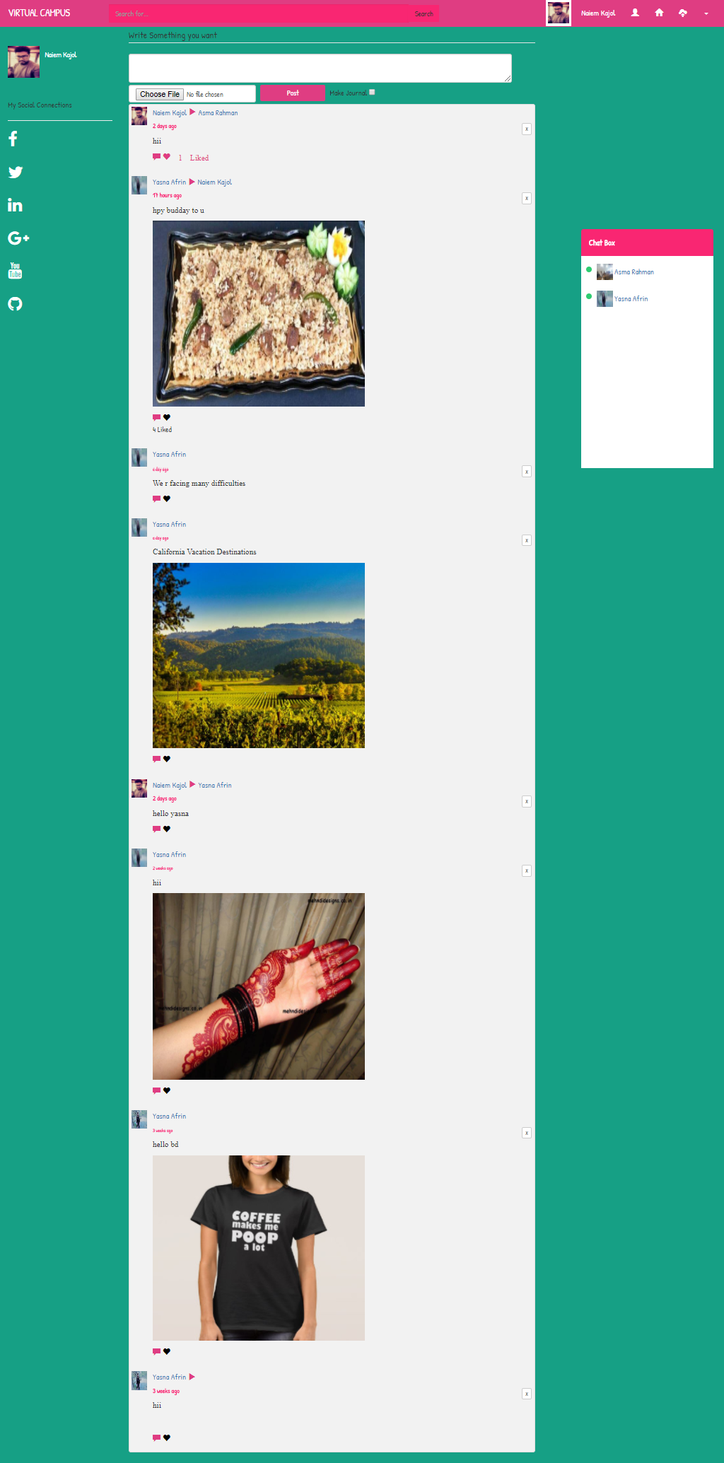
Home Page

Slide 17
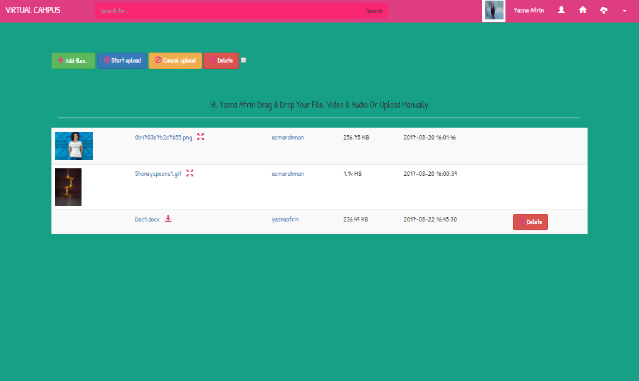
Virtual Campus drag and drop box

Slide 18
Operating Manual of Virtual Campus
Add classmate, Leave classmate.
Share important posts.
Friend Request options.
Update, delete post status.
Online chatting, file sharing, presenting important news and opinions.
Update profile information, change bio-data.
Upload and download audios,videos,files.
Sharing audios,videos,photos, files.
Timeline Option.
Like System
Sign up/Registration.
Sign in/Login.

Slide 19
Conclusion
The project Virtual Campus is for computerizing the working in a campus on online.
The software takes care of all the requirements of an a campus and is capable to provide easy and effective storage of information like file-sharing, presenting important posts, status, opinions,audios,videos,photos related to teachers and students.
Thank you all

